Slide 1
Chapter 13
Business

Slide 2
Industrial/Organizational Psychology
The study of human behavior in business and other organizational settings
The impact of social psychological factors in the workplace was first recognized in Western Electric Company’s Hawthorne plant studies (1924-1932)
  Hawthorne effect: Workers who were given special attention increased their productivity regardless of what actual changes were made in the work setting.

Slide 3
The Typical Job Interview (1 of 2)
Do interviews promote sound hiring?
Research suggests interviewing has mixed effects
  Possibility of race and ethnic background biases, race may at times shape whether an applicant is interviewed in the first place.
  Bertrand & Mullainathan (2004)
  Cotton et al. (2007) “common vs unique names”

Slide 4
The Typical Job Interview (2 of 2)
Although interviews often result in the right selection of new employees, they sometimes lack predictive validity.
  Most job applicants use impression management tactics to present themselves in a positive light.

Slide 5
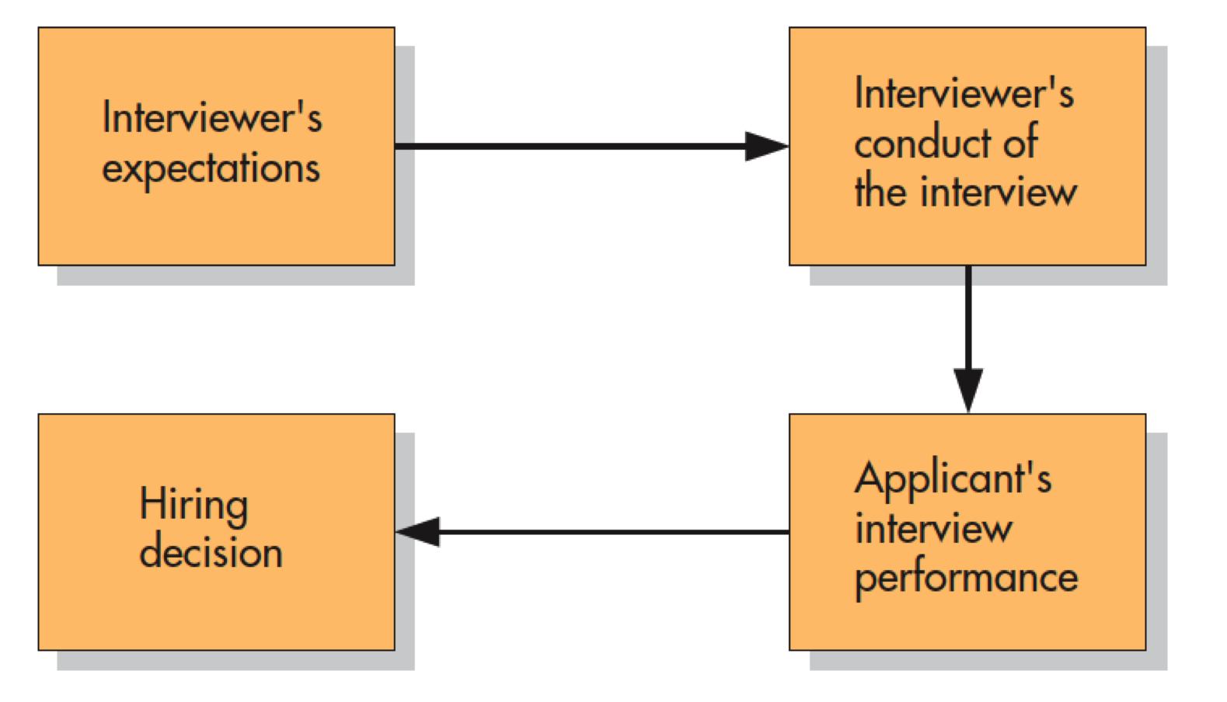
Job Interviews: A Self-Fulfilling Prophecy?
Notes:
Figure 13.1 Job Interviews: A Self-Fulfilling Prophecy? One study indicates that interviewers’ expectations influence the kinds of interviews conducted and applicants’ performance. The higher the expectations, the more the interviewer tries to impress rather than evaluate the applicant and make a favorable hiring decision. Without realizing it, employers may use job interviews to create a reality that supports their prior beliefs. Phillips and Dipboye, 1989

Slide 6
Cybervetting
Using the Internet to get informal, noninstitutional data about applicants that they did not choose to share
Many employers reported cybervetting good applicants after receiving their résumés.
  Seeking visual, textual, technological, and relational information
No research exists on the effects of cybervetting on the quality of hiring decisions.

Slide 7
“Scientific” Alternatives to Traditional Interviews
Standardized tests
  Intellectual and cognitive abilities
  Job-specific knowledge and skills
  “Street smarts” and common sense
Personality tests
Integrity tests

Slide 8
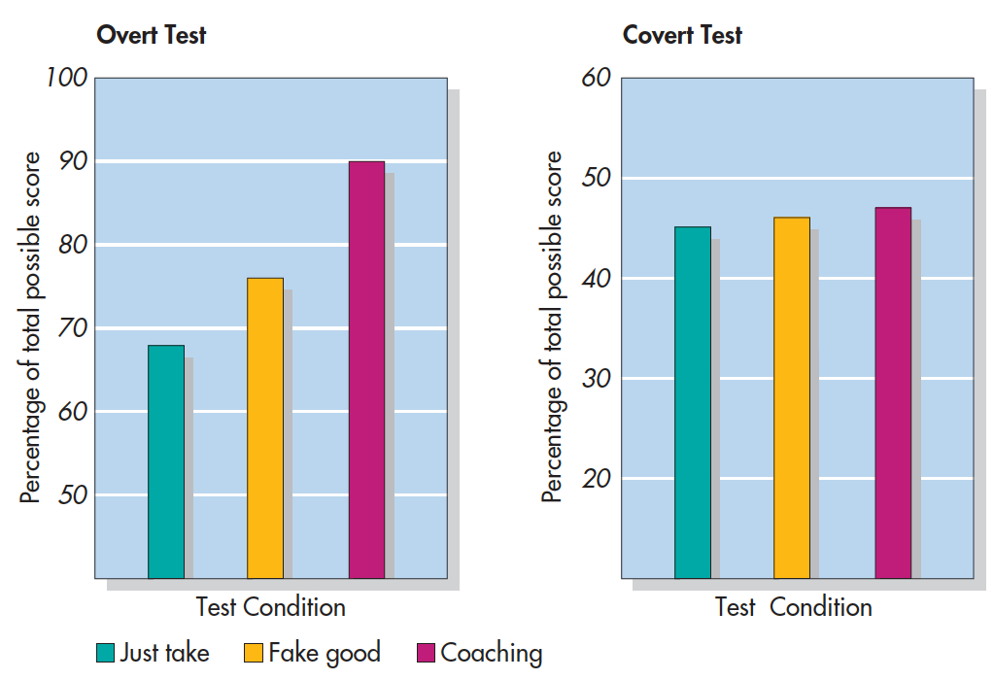
Can Integrity Tests Be Faked? (Alliger et al., 1996)
Notes:
Figure 13.2 Can Integrity Tests Be Faked? Alliger and others (1996) gave college students overt and covert integrity tests. Some just took the test, others were told to “fake good,” and others were coached. On the overt test, scores increased for subjects who faked good or were coached (left). On the covert test, scores were unaffected by these interventions (right). Alliger et al., 1996

Slide 9
Structured Interviews
Structured interview—an interview in which each job applicant is asked a standard set of questions and evaluated on the same criteria.
Assessment center—a structured setting in which job applicants are exhaustively tested and judged by multiple evaluators.

Slide 10
Personnel Selection as a Two-Way Street
How do applicants feel about the hiring process?
  People see concrete, job-specific tests, and interview situations as the most fair.
  They dislike impersonal standardized tests of intelligence, personality, and honesty.

Slide 11
Leadership: The Classic Trait Approach
What traits characterize “natural born” leaders?
Ambition, intelligence, a need for power, self-confidence, a high energy level, and an ability to be flexible and adapt to change
Situationally oriented theories:
  Emergence of a given leader depends on time, place, and circumstances.

Slide 12
Contingency Models of Leadership
The theory that leadership effectiveness is determined both by the personal characteristics of leaders and by the control afforded by the situation.

Slide 13
Fred Fiedler’s Contingency Model of Leadership
Key difference among leaders is whether they are primarily task-oriented or relations-oriented.
  Do you focus on the job at hand or the people doing the job?
Task-oriented leaders are most effective in clear-cut situations that are either low or high in control.
Relations-oriented leaders perform better in situations that afford a moderate degree of control.

Slide 14
Normative Model of Leadership
The theory that leadership effectiveness is determined by the amount of feedback and participation that leaders invite from workers
For effective long-term leadership, the key is to invite just the right amount of worker participation—not too much
  The “right amount” depends on various factors.

Slide 15
Transactional Leadership
Gains compliance and support from followers by setting clear goals for them, by offering tangible rewards, by providing assistance, and by fulfilling psychological needs
Effectiveness depends on the leader’s willingness and ability to reward subordinates who keep up their end of the bargain.
  And to correct those who do not

Slide 16
Transformational Leadership
Motivate others to transcend their personal needs in the interest of a common cause.
  Particularly in times of growth, change, and crisis
Articulate a clear vision of the future and then mobilize others to join in that vision.

Slide 17
Leadership Among Women
Working women and minorities are extremely underrepresented in top leadership positions.
What is now a massive amount of research literature on sex differences in leadership.
  Only difference seems to be that men are more controlling and women are more democratic in their approaches.

Slide 18
Employee Motivation
Vroom’s expectancy theory—Workers become motivated and exert effort when they believe:
  Their effort will result in an improved performance
  Their performance will be recognized and rewarded
  The monetary and symbolic rewards that are offered are valuable and desirable.
The key, they maintain, is for people to set specific and difficult goals for themselves or others.

Slide 19
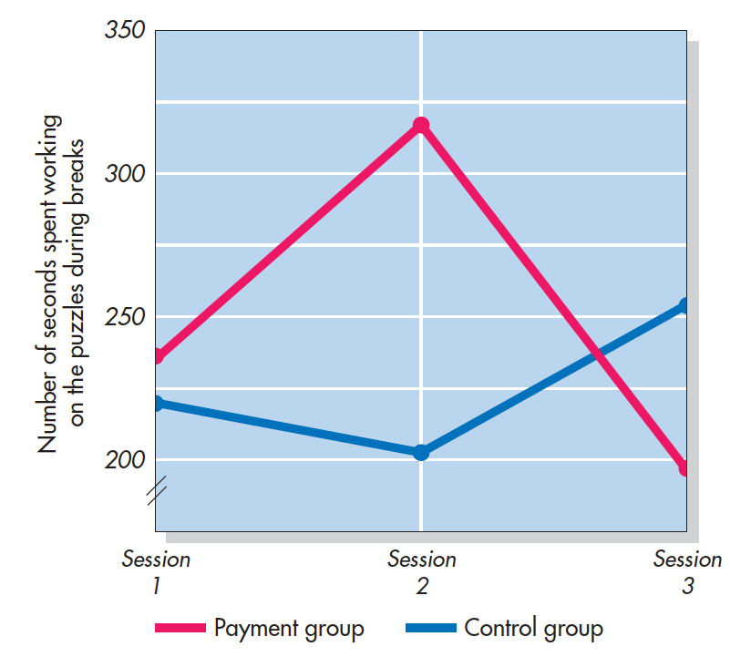
The Effect of Payment on Intrinsic Motivation (Deci 1971)
Participants completed puzzles in three different sessions (time spent was dv)
Session 1: No one was paid
Session 2: Half were paid
Session 3: Money was taken away. How did motivation change?
Notes:
Figure 13.6 The Effect of Payment on Intrinsic Motivation: Turning Play Into Work In this study, participants worked three times on puzzles they found interesting. After each session, the amount of free time participants spent on the puzzles served as a record of their intrinsic motivation. During the second session, half of the participants were paid for puzzles they completed and half were not. Those paid in the second session later showed less interest in the puzzles when the money was no longer available. Deci (1971).

Slide 20
Equity Considerations
According to equity theory, people want rewards to be equitable.
  Being overpaid or underpaid will cause distress.
To relieve the distress caused by perceived inequity
  Restoring actual equity
  Convincing yourself that equity already exists.

Slide 21
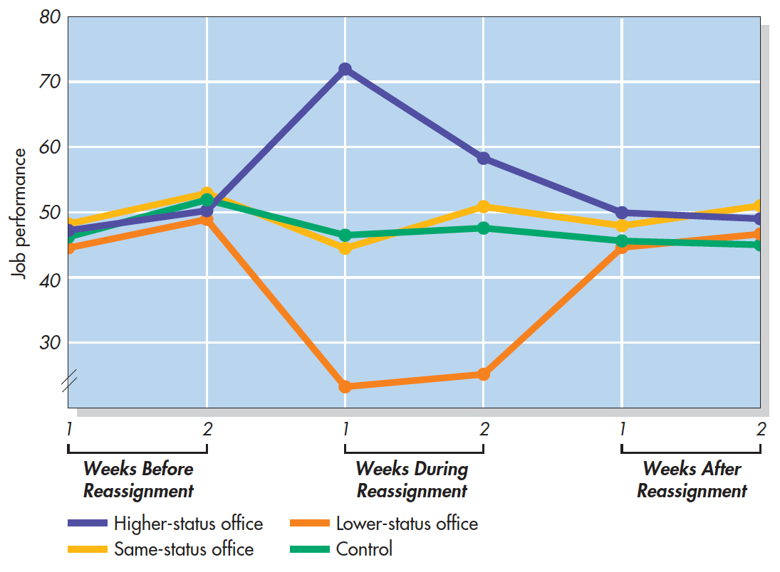
Equity in the Workplace (Greenberg, 1988)
Notes:
Figure 13.7 Equity in the Workplace Insurance company workers were moved temporarily to offices that were the workplaces of those who were higher, lower, or equal in status to their own rank. Supporting equity theory, those assigned to the offices of higher-status individuals increased their job performance, and those sent to offices of lower-status individuals showed a decrease. When workers were reassigned to their original offices, productivity levels returned to normal. Greenberg (1988).

Slide 22
The Gender Wage Gap
Equity in the workplace is important—and it may mean different things for men and women.
What factors contribute to the gender pay gap?
  Are women valued less?
  Or are women are less assertive at negotiating starting salaries?

Slide 23
Income and Job Satisfaction
Is there a link between income levels and job satisfaction?

Slide 24
The Progress Principle
Through a meta-analysis of 92 studies that reported correlations between pay and various aspects of job satisfaction, Timothy Judge and his colleagues (2010) found that although the correlation is greater than zero, people's level of satisfaction at work was only weakly correlated with how much they were paid.

Slide 25
The Symbolic Power of Money
“Money changes people at a core, basic level” and “having money makes people feel less connected and more independent, whereas having little money makes you feel more interdependent with others.”
In research studies, people primed with money start to focus on matters of price, trade, economics, and the virtues of a free market, and they become more likely to succeed.

Slide 26

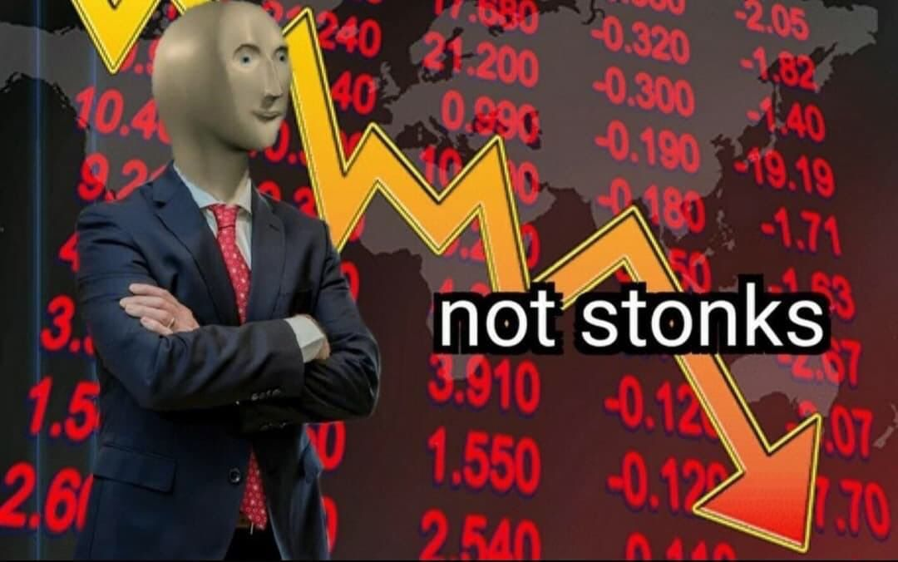
Social Influences in the Stock Market (1 of 2)
To what extent is the stock market influenced by fear, greed, false beliefs, financial analysts who appear on TV, rumors that spread over the Internet, conformity pressures, and other social influences, all compounded by the speed and volume with which traders can buy and sell stocks online?

Slide 27
Social Influences in the Stock Market (2 of 2)
Misperceptions of random events, misattributions, and even unpublished rumors can influence decisions of investors.
  Assumption of continuity
Endowment effect: The tendency for people to inflate the value of objects, goods, or services they already own.

Slide 28
Sunk Cost Principle
Only future costs and benefits, not past commitments, or “sunk costs” should be considered in making a decision.
People often violate the sunk cost principle of economics.
Economic decisions are biased by past investments of time, money, and effort.

